Slide 1
Volcanoes on Mars
The Fires of Ares
Europlanet 2024 RI has received funding from the European Union’s Horizon 2020 research and innovation programme under grant agreement No 871149.

Slide 2
Objectives
By the end of this lesson, you will be able to:
Understand how volcanoes form
Explain what convection is and why we would find it inside a volcano
Determine the habitability of volcanoes on both Earth and Mars

Slide 3
Types of Volcano
Composite Volcano
Cinder Cone Volcano
Shield Volcano

Slide 4
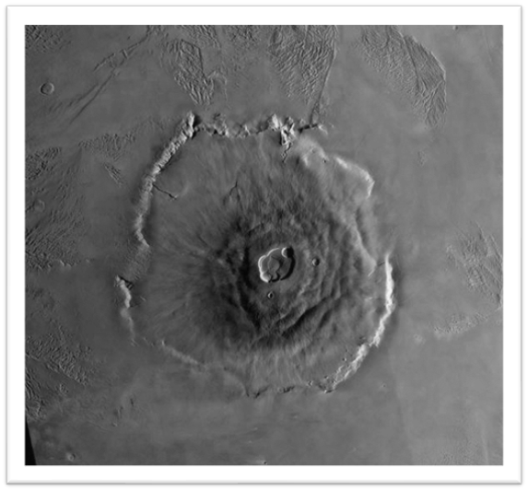
Olympus Mons: Shield Volcano
Image credit: NASA

Slide 5
How do Shield Volcanoes Form?
Click button below to link to video:

Slide 6
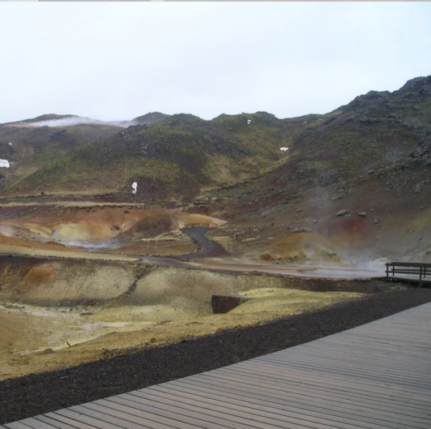
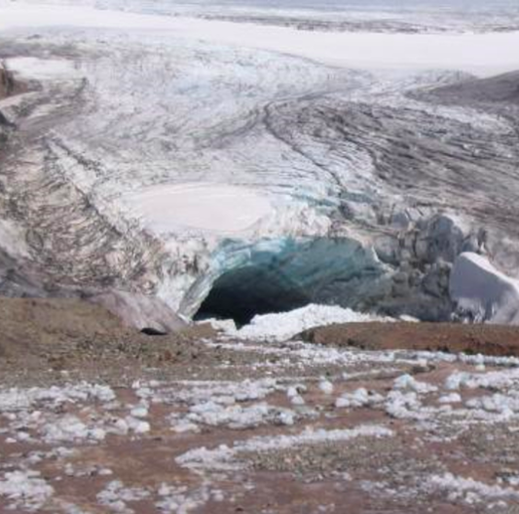
Iceland Field Sites
Image sources: Europlanet 2024 RI, Matis
Can be used as analogues to volcanic areas of Mars, such as Olympus Mons.

Slide 7
Convection

Slide 8
How does convection work?
Click button below to link to video:

Slide 9
Life on Mars? Do you think any kind of life could survive inside volcanoes?
Remember that:
Volcanoes spew out hot, acidic lava!
The inside of a volcano is under a lot of pressure!

Slide 10
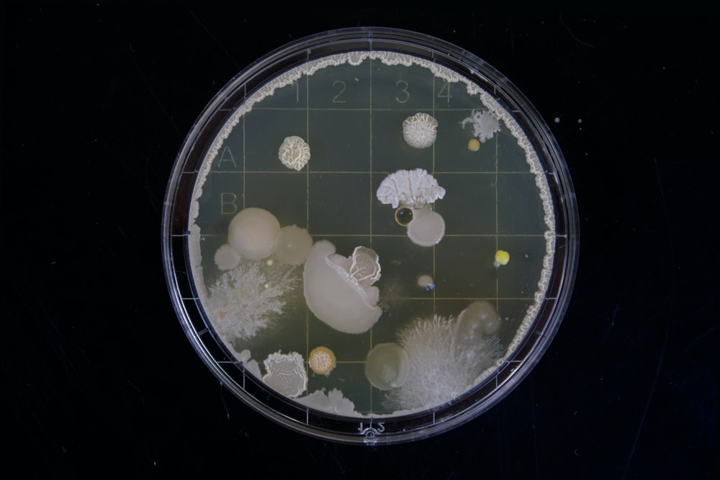
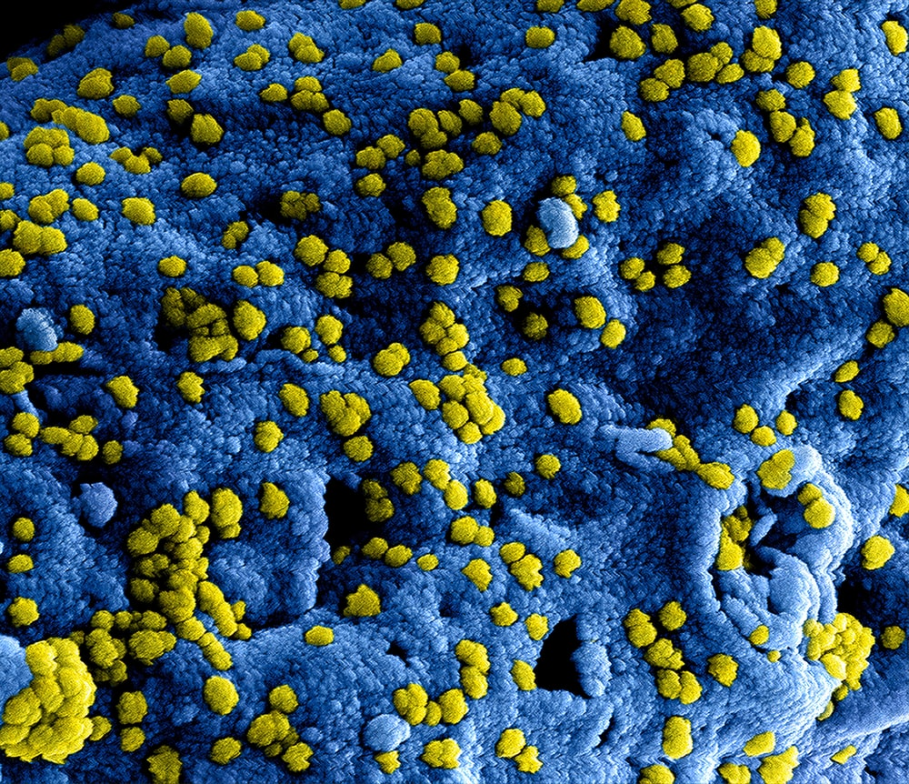
The Extremophiles!
WHAT ABOUT MICRO-ORGANISMS?

Slide 11
Recap
1
2
3
Understand the type of volcanoes found on Mars and how they formed.
Explain what convection is and why it occurs in a volcano.
Determine the habitability of volcanoes (on Earth and Mars!).
Now we can...

